Slide 1
Special matrices int a[5][6] a[i][j] a[4][5]
a sparse matrix or sparse array is a matrix in which most of the elements are zero. By contrast, if most of the elements are nonzero, then the matrix is considered dense. The number of zero-valued elements divided by the total number of elements (e.g., m × n for an m × n matrix) is called the sparsity of the matrix (which is equal to 1 minus the density of the matrix). Using those definitions, a matrix will be sparse when its sparsity is greater than 0.5.

Slide 2
Diagonal matrix
tridiagonal

Slide 3
1 2 3 4
4 5 6 5 3x4
7 8 9 6
1 2 3 4 4 5 6 5 ……
1 4 7 2 5 8
Baseaddress + s*(n*(i) + J)-row major
Baseaddress + s*(m*(j) + i)-colomn major

Slide 4
Int music_Listeners[100][1000]
Purchase[1000][20000]
A[i][j] M N
For(i=0 i< M; i++)
for(j=0; j<N; j++)
a[i][j]=0
for(j=0; j<N; j++)
a[j][j]=10

Slide 5
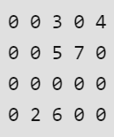
Storage: There are lesser non-zero elements than zeros and thus lesser memory can be used to store only those elements.
Computing time: Computing time can be saved by logically designing a data structure traversing only non-zero elements..

Slide 6
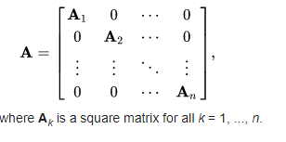
Diagonal Matrix

Slide 7
Int n;
Int Retrieve (int a[], int i, j )
{
If(i>n-1 || j>n-1 || i<0 || j<0)
printf(“error”)
Else{
If(i==j)
ele=a[i]
else
{
ele=0;
}
Return ele;
}

Slide 8
Int n;
Int Retrieve (int a[], int i, j )
{
If(i>n-1 || j>n-1 || i<0 || j<0)
printf(“error”)
Else{
If(i==j)
a[i-1] =ele
else
{
ele=0;
}
Return ele;
}

Slide 9
Int a[100]
Main()
Read n
For (i=0; i<n; i++)
For (j=0; j<n; j++)
{
sf(ele)
store(a,I,j,ele)
}
For (i=0; i<n; i++)
For (j=0; j<n; j++)
retrieve(a,I,j,ele)
pf(“ %d”,ele)

Slide 10
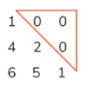
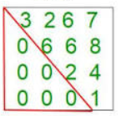
Triangular matrix
a triangular matrix is a special kind of square matrix. A square matrix is called lower triangular if all the entries above the main diagonal are zero. Similarly, a square matrix is called upper triangular if all the entries below the main diagonal are zero.
1+2+3+4+…+n= n(n+1)/2
a[] i=5 j=3 a[i][j]
0 1 2 3 4 5
1 4 2 6 5 1
A[i][j] 1 2 3…….i= I (I+1)/2
If (i,>j)
1 2 3 4 5 ……= 5 *6/2
i*(i+1)/2+j

Slide 11
Int n;
Int store(int a[], int i, j )
{
If(i>n-1 || j>n-1 || i<0 || j<0)
printf(“error”)
Else{
If(i>j)
{
loc=i*(i+1)/2 +j
a[loc]=ele
else
{
ele=0;
}
Return ele;
}

Slide 12
Int n;
Int retrieve (int a[], int i, j )
{
If(i>n-1 || j>n-1 || i<0 || j<0)
printf(“error”)
Else{
If(i>j)
{
loc=i*(i+1)/2 +j
ele=a[loc]
else
{
ele=0;
}
Return ele;
}

Slide 13
5x5 =25 5+4+4=13 i-j=0 i-j >0 i-j<0 a[i][j] 6x6 a[3][4]
1 | 4 | 0 | 0 | 0
5 | 2 | 6 | 0 | 0
0 | 8 | 6 | 3 | 0
0 | 0 | 9 | 5 | 6
0 | 0 | 0 | 6 | 9

Slide 14
instead of storing zeroes with non-zero elements, we only store non-zero elements. This means storing non-zero elements with triples- (Row, Column, value).
Array representation
Linked list representation
Row: Index of row, where non-zero element is located
Column: Index of column, where non-zero element is located
Value: Value of the non zero element located at index – (row,column)

Slide 15
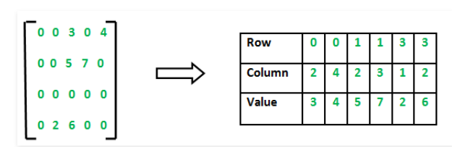

Slide 16
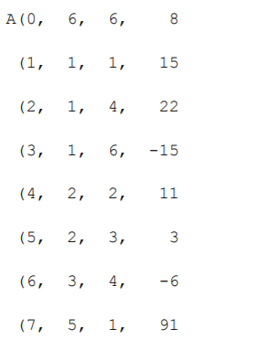
00000

Slide 18
Structure Sparse_Matrix is objects: a set of triples, <row, column, value>, where row and column are integers and form a unique combination, and value comes from the set item. functions: for all a, b ∈ Sparse_Matrix, x  item, i, j, max_col, max_row  index Sparse_Marix Create(max_row, max_col) ::= return a Sparse_matrix that can hold up to max_items = max _row  max_col and whose maximum row size is max_row and whose maximum column size is max_col.
SPARSE MATRIX ABSTRACT DATA TYPE

Slide 19
Sparse_Matrix Transpose(a) ::= return the matrix produced by interchanging the row and column value of every triple. Sparse_Matrix Add(a, b) ::= if the dimensions of a and b are the same return the matrix produced by adding corresponding items, namely those with identical row and column values. else return error Sparse_Matrix Multiply(a, b) ::= if number of columns in a equals number of rows in b return the matrix d produced by multiplying a by b according to the formula: d [i] [j] = (a[i][k]•b[k][j]) where d (i, j) is the (i,j)th element else return error.
* Structure 2.3: Abstract data type Sparse-Matrix (p.68)

Slide 21
(1) Represented by a two-dimensional array.
Sparse matrix wastes space.
(2) Each element is characterized by <row, col, value>.
row col value row col value a[0] 6 6 8 b[0] 6 6 8 [1] 0 0 15 [1] 0 0 15 [2] 0 3 22 [2] 0 4 91 [3] 0 5 -15 [3] 1 1 11 [4] 1 1 11 [4] 2 1 3 [5] 1 2 3 [5] 2 5 28 [6] 2 3 -6 [6] 3 0 22 [7] 4 0 91 [7] 3 2 -6 [8] 5 2 28 [8] 5 0 -15
# of rows (columns)
# of nonzero terms
transpose
(a) (b)
row, column in ascending order
*Figure 2.4:Sparse matrix and its transpose stored as triples (p.69)

